Slide 1
Gaussian processes to model chemotactic movement of droplets
Carlotta Porcelli, Bioinformatic Project 1, 26 August 2017

Slide 2
Contents
Introduction
The software
Results and discussion
Future work

Slide 3
Introduction
The research behind the project
The chemical system
The data set
Gaussian Processes

Slide 4
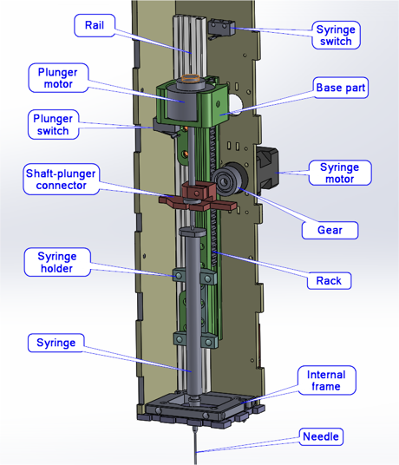
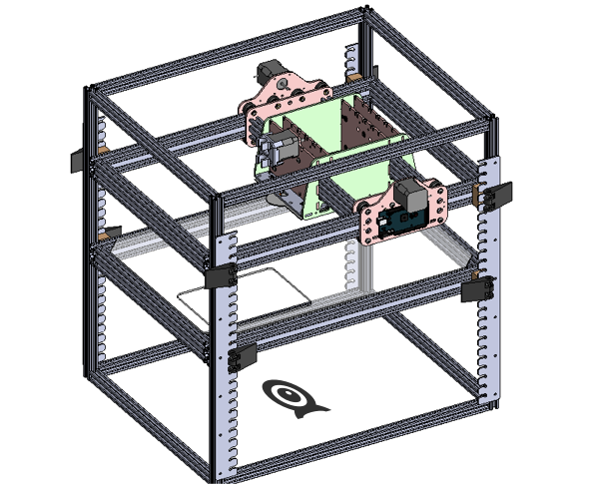


The research behind the project
Development of a robotic platform
Optimize the performance of a physicochemical system and its environment
Handling liquids robot + computer vision analysis

Slide 5
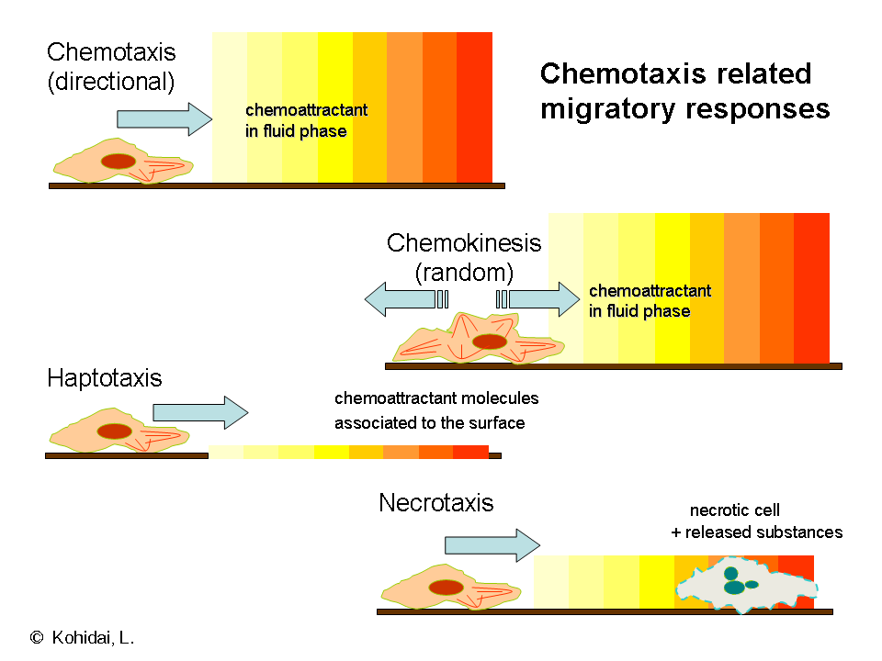
The chemical system
Decanoate acid solutions
pH: 7 - 12.3
molarity: 5mM-20mM
1-Decanol oil droplet + Oil Red O lysochrome
Sodium Chloride – NaCl 3.5M
Environment variables
salt source
oil droplet

Slide 6
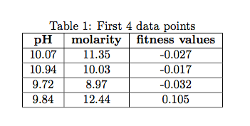
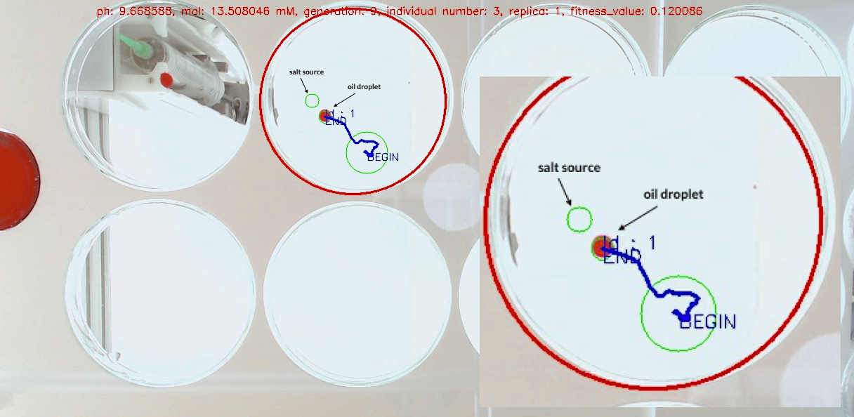
The data set
73 observations
3 features:
2 variables: pH and molarity
1 score: fitness value

Slide 7
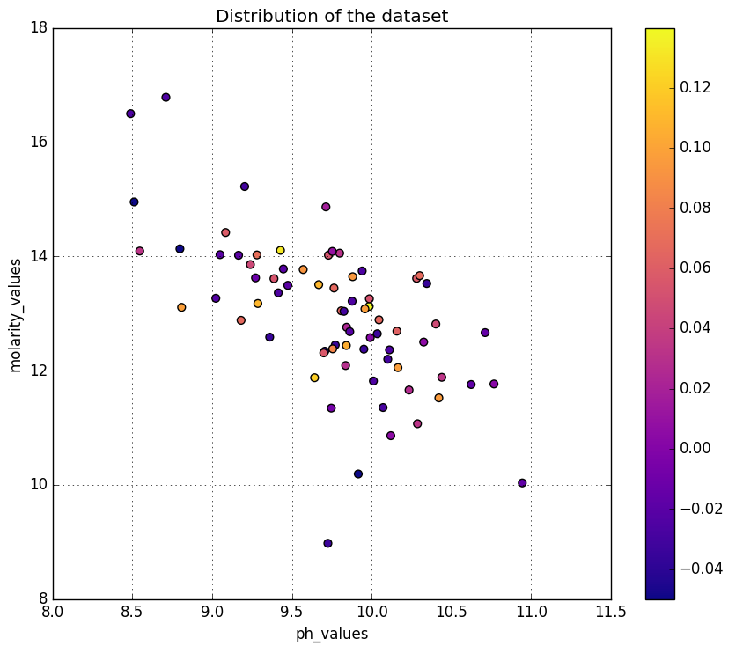
collected from evolutionary algorithm
CMA-ES: Covariance Matrix Adaptation Evolution Strategy
in each generation new individuals are generated by variation of current ‘parent individuals’
some are selected to become parents in the next generation based on their fitness value
over generations individuals with better fitness values are selected

Slide 8
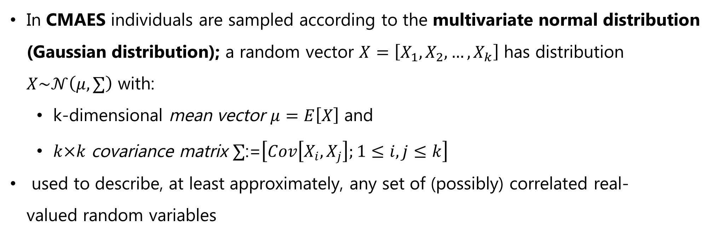
Gaussian processes
A Gaussian Process (GP) is a distribution over functions
In CMAES individuals are sampled according to the multivariate normal distribution (Gaussian distribution); a random vector $X=\left[X_{1},X_{2}, …,X_{k}\right]$ has distribution $X\sim 𝒩\left(μ, ∑\right)$ with:
k-dimensional mean vector $μ=E\left[X\right]$ and
$k×k$ covariance matrix $∑$:=$\left[Cov\left[X_{i},X_{j}\right];1≤i,j≤k\right]$
used to describe, at least approximately, any set of (possibly) correlated real-valued random variables
Gaussian process uses lazy learning and a measure of the similarity between points (the kernel function) to predict the value for an unseen point from training data

Slide 9
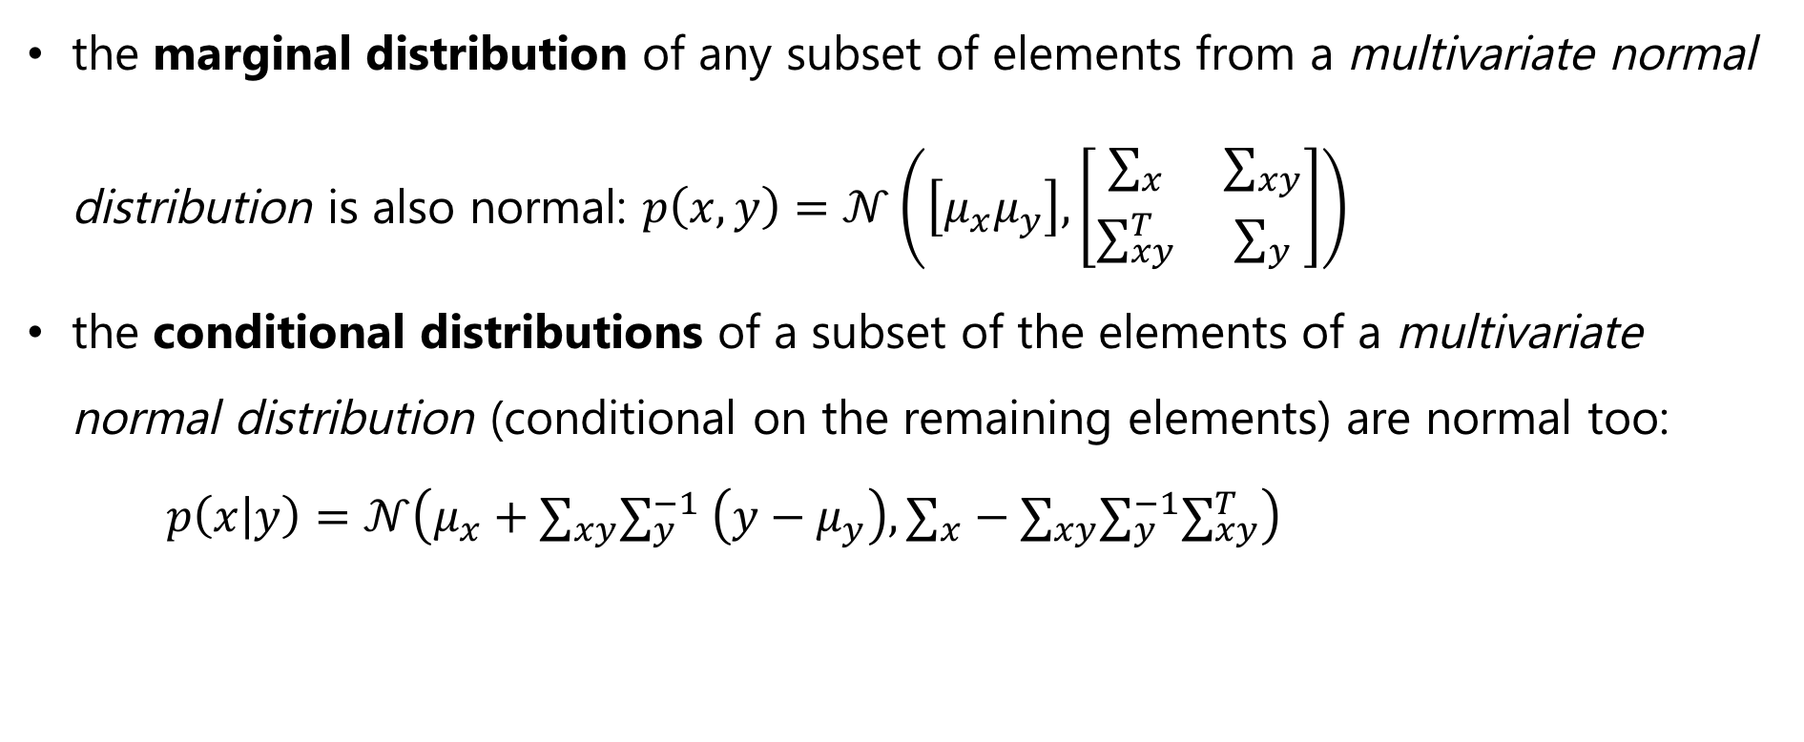
the marginal distribution of any subset of elements from a multivariate normal distribution is also normal: $p\left(x,y\right)=$ $𝒩\left(\left[μ_{x}μ_{y}\right],\left[\begin{matrix}∑_{x} & ∑_{xy} \\ ∑_{xy}^{T} & ∑_{y}\end{matrix}\right]\right)$
the conditional distributions of a subset of the elements of a multivariate normal distribution (conditional on the remaining elements) are normal too: $p\left(x | y\right)=$ $𝒩\left(μ_{x}+∑_{xy}∑_{y}^{−1} \left(y−μ_{y}\right),∑_{x}−∑_{xy}∑_{y}^{−1}∑_{xy}^{T}\right)$

Slide 10
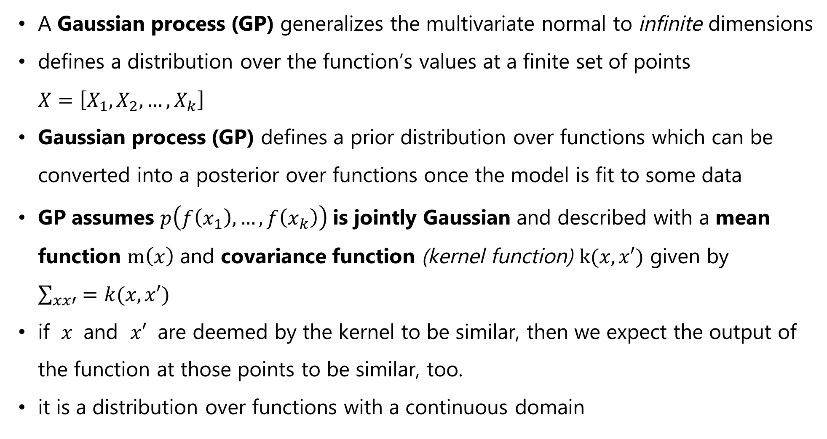
A Gaussian process (GP) generalizes the multivariate normal to infinite dimensions
defines a distribution over the function’s values at a finite set of points $X=\left[X_{1},X_{2}, …,X_{k}\right]$
Gaussian process (GP) defines a prior distribution over functions which can be converted into a posterior over functions once the model is fit to some data
GP assumes $p\left(f\left(x_{1}\right),…, f\left(x_{k}\right)\right)$ is jointly Gaussian and described with a mean function $m\left(x\right)$ and covariance function (kernel function) $k(x,x′)$ given by $\sum_{xx′}{=k(x, x′)}$
if $x$ and $x′$ are deemed by the kernel to be similar, then we expect the output of the function at those points to be similar, too.
it is a distribution over functions with a continuous domain

Slide 11
The prediction interpolates the observations (for regular kernels).
The prediction is probabilistic (Gaussian), it is possible to compute empirical confidence intervals
Versatile: different kernels can be specified

Slide 12
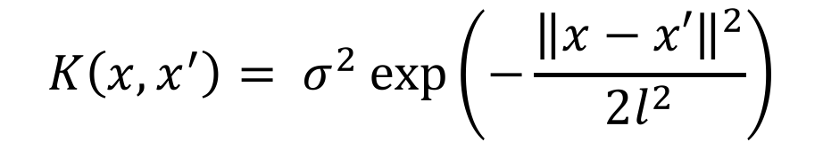
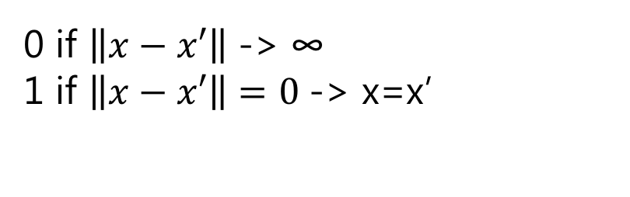
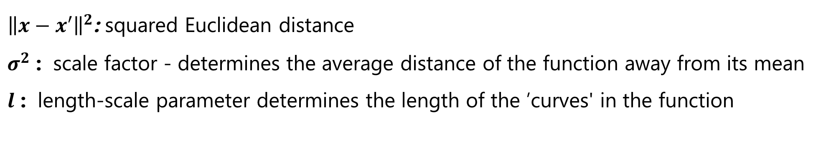
Radial Basis Function kernel
$$K\left(x, x^{′}\right)= σ^{2}\exp\left(−\frac{{\left\|x−x′\right\|}^{2}}{2l^{2}}\right)$$
0 if $\left\|x−x′\right\|$ -> ∞
1 if $\left\|x−x′\right\|=0$-> x=x’
${\left\|x−x′\right\|}^{2}$: squared Euclidean distance
$σ^{2}$ : scale factor - determines the average distance of the function away from its mean
$l$ : length-scale parameter determines the length of the ’curves' in the function
standard kernel
interpretation as a similarity measure

Slide 13
Contents
Introduction
The software
Results and discussion
Future work

Slide 14
The software
GPy is a Gaussian Process (GP) framework written in python, from the Sheffield machine learning group. http://sheffieldml.github.io/GPy/
# choice of kernel
kg = GPy.kern.RBF(input_dim=2, variance=0.5, lengthscale=1., ARD=True)
# instantiation of the model
model = GPy.models.GPRegression(x_set, y_set, kernel=kg, normalizer=False, noise_var=1.)
variance: variation of function values from their mean
lengthscale: dictates the smoothness of the function
noise_var: how much noise is expected to be present in the data
# optimization of the parameters
model.optimize(messages=True, max_f_eval=1000)
# run the algorithm 10 using randomly-chosen starting coordinates – avoid finding local maximum
model.optimize_restarts(num_restarts=10)

Slide 15
Contents
Introduction
The software
Results and discussion
Future work

Slide 16
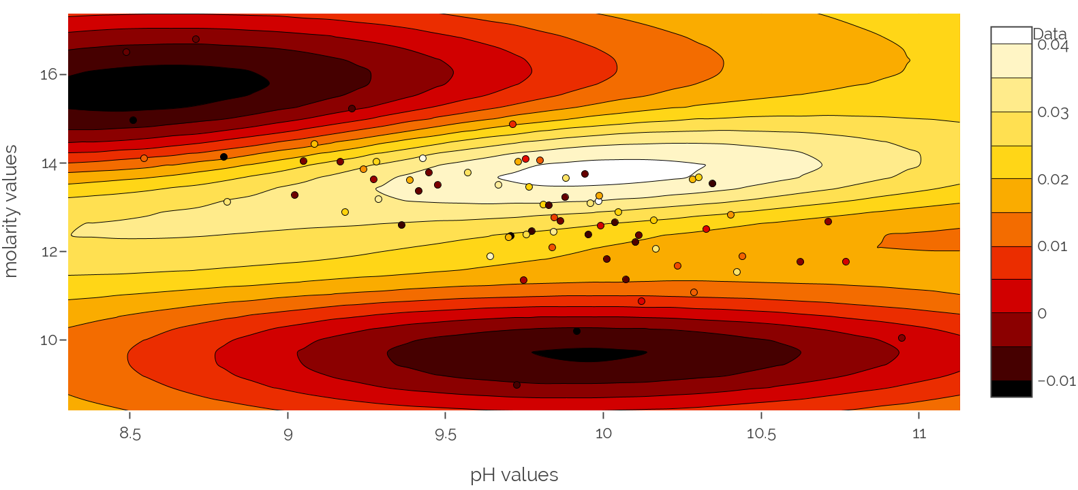
Results and discussion
Model before optimization

Slide 17
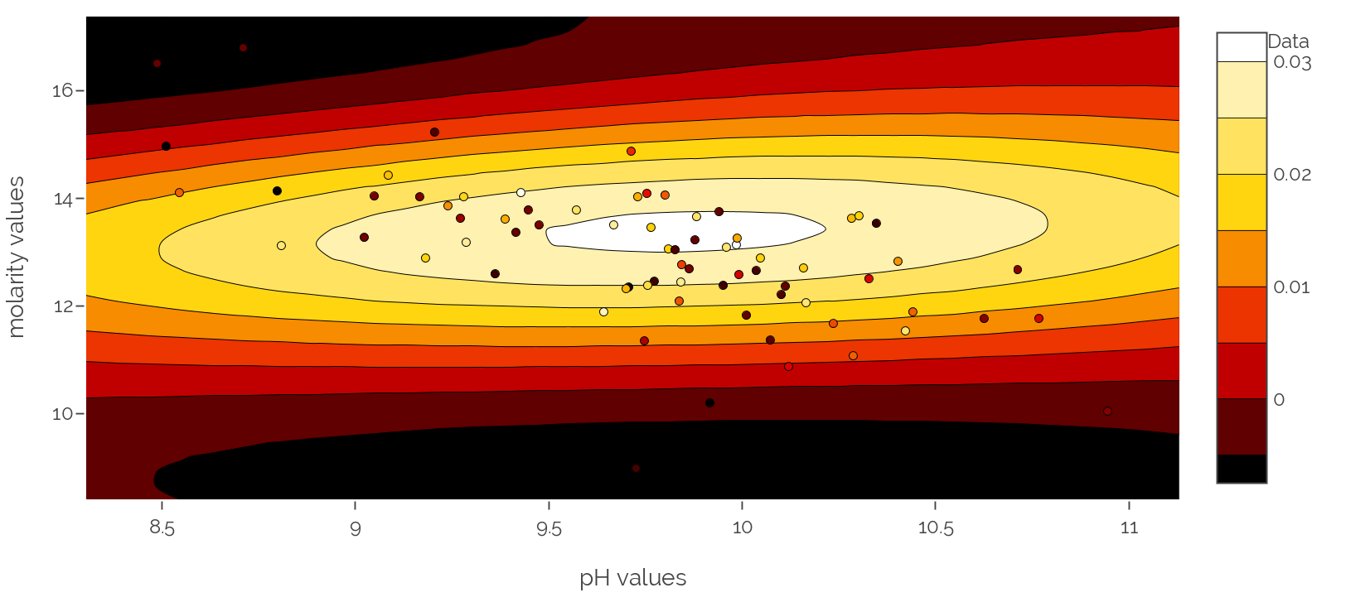
Model after optimization

Slide 18
Contents
Introduction
The software
Results and discussion
Future work

Slide 19
Future work
Change in the protocol for preparing decanoate solutions: stabilize the system
Cover for the petri dishes: avoid air flows affecting the system
Different kernels exploration: the effect of sum and product
Test experiments within the found ranges of pH and molarity

Slide 21
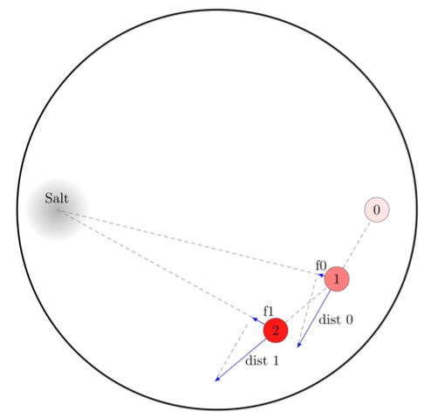
The fitness value
0 is the initial position of the droplet when the tracking starts.
After 8 camera frames, the droplet has moved to position 1
The vector dist 0 is projected on the axis droplet-salt
The partial fitness, f0 is calculated.
The same procedure is repeated every 8 frames.
The total fitness is the sum of the partial fitness divided by the a constant plus the total number of frames.
Each individual is tested 4 times, the median value is taken as final fitness value

